Slide 1



THANTHAI PERIYAR GOVERNMENT INSTITUTE OF TECHNOLOGY,VELLORE-02 .
Internship on embedded testing
VAAYUSASTRA AEROSPACE PRIVATE LIMITED
TEAM MEMBERS
EZHILARASI M 513121106025
MANIMARAN V 513121106302

Slide 2
ABSTRACT
The work focuses on testing the functionality and performance of embedded systems. It involves assisting in the development and execution of testing procedures to ensure the reliability and accuracy of these systems. The final project entailed the development of an image-to-text-to-speech conversion system using Raspberry Pi, where text from images is extracted and converted into speech. This experience not only enhanced knowledge of embedded systems and testing tools but also emphasized the importance of strict safety and performance standards in aerospace technology.

Slide 3
methodology
Worked with various embedded components, focusing on interfacing techniques and real-time testing.
Implemented the automated testing frameworks to validate system functionality and used error detection methods to improve system reliability.
Additionally, I applied debugging tools to troubleshoot issues efficiently, ensuring smooth operation of embedded systems.
Optimized by enhancing code efficiency and minimizing memory usage for better performance and power management.

Slide 4
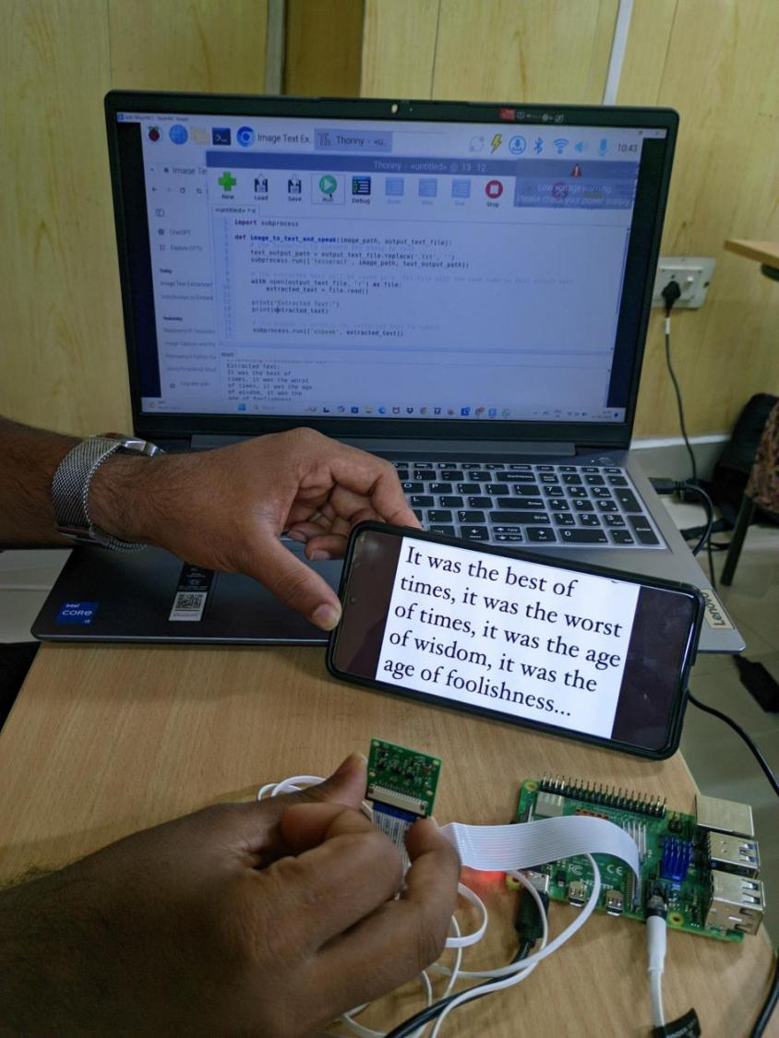
PROJECT DEVELOPMENT
IMAGE TEXT TO SPEECH CONVERSION USING RASPBERRY PI
The Project aims to develop a tool that converts printed text into speech using a Raspberry Pi, aiding visually impaired individuals.
The system captures images of text using a camera module, processes these images with OpenCV, and extracts text through Tesseract OCR.
The development involves setting up the Raspberry Pi, writing scripts for image capture and processing, and ensuring accuracy through testing.

Slide 5
conclusion
The exposure to advanced techniques and real-world problem-solving scenarios has greatly enhanced our understanding and skill set. Through hands-on tasks, we have developed a deeper insight into the core processes, refining our technical abilities and analytical thinking. This journey has equipped us with the confidence and competence to tackle future challenges with a practical and innovative approach, preparing us for the next steps in our professional development.

Slide 6
Problem identification
Current tools facing challenges with accuracy in recognizing varied text formats and providing immediate auditory feedback, which can hinder usability and effectiveness. This project aims to develop a cost-effective, portable solution using Raspberry Pi that captures images of text, accurately recognizes and converts it to speech in real-time, thereby enabling individuals with visual impairments to independently access and interpret textual information in their environment.

Slide 7
THANK YOU

